Slide 1


Win Prediction Analytics Data Science Pro-degree Project KPMG Knowledge Partner
DSP-16 Group 2
Ashok Acharya
Magesh S
Meghana Nayak
Sathish Kumar
Surbhi Sanklecha

Slide 2

Objectives
1: Predictive Analytics - Build a ML model to predict the probability of win/loss for bidding activities for a potential client.
2: Prescriptive Analytics – Identify variable/s that are most likely to help in converting an opportunity into a win.

Slide 3

Data Exploration and Understanding
Dependent Variable: Deal Status Cost (Win and Lost)
Independent Variable: 8 variables excluding target variable
No of Observation in the data: 10061
Data Sample year: 2011 to 2019
All variables are in string format except Deal Cost and Deal Date

Slide 4

Data Overview and Description
Column Name | Description
Client Category | Industry in which the client works
Solution Type | The solution group the client requires
Deal Date | The date the opportunity was created
Sector | The sector for which the solution is to be provided
Location | Client location
VP Name | Sr. Manager or VP which is dealing with the client
Manager Name | Manager of the team working on the project
Deal Cost | The initial cost of the deal
Deal Status Code | Final status of the deal(won/lost)

Slide 5


Unique Values in Each Column
Variables | Counts
Client Category | 41
Solution Type | 67
Deal Date | 2555
Sector | 25
Location | 13
VP Name | 43
Manager Name | 277
Deal Cost | 1165
Deal Status Code | 2

Slide 6
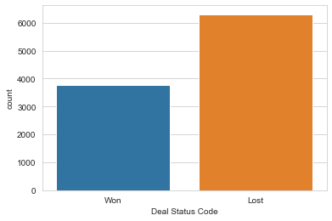
EDA: Deal Status Code Counts

Slide 7
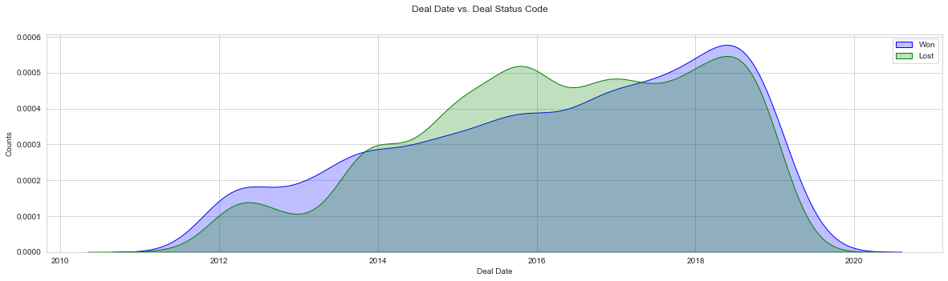
EDA: Deal Status Code Over The Years

Slide 8
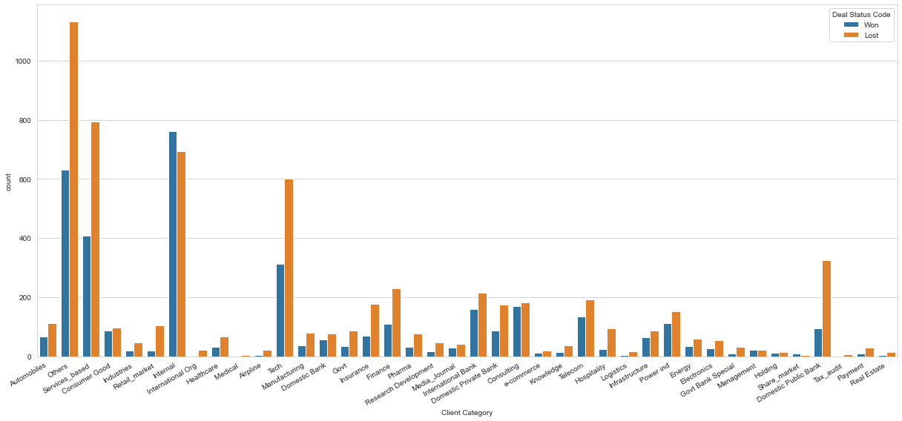
EDA: Client Category wrt Deal Status Code

Slide 9
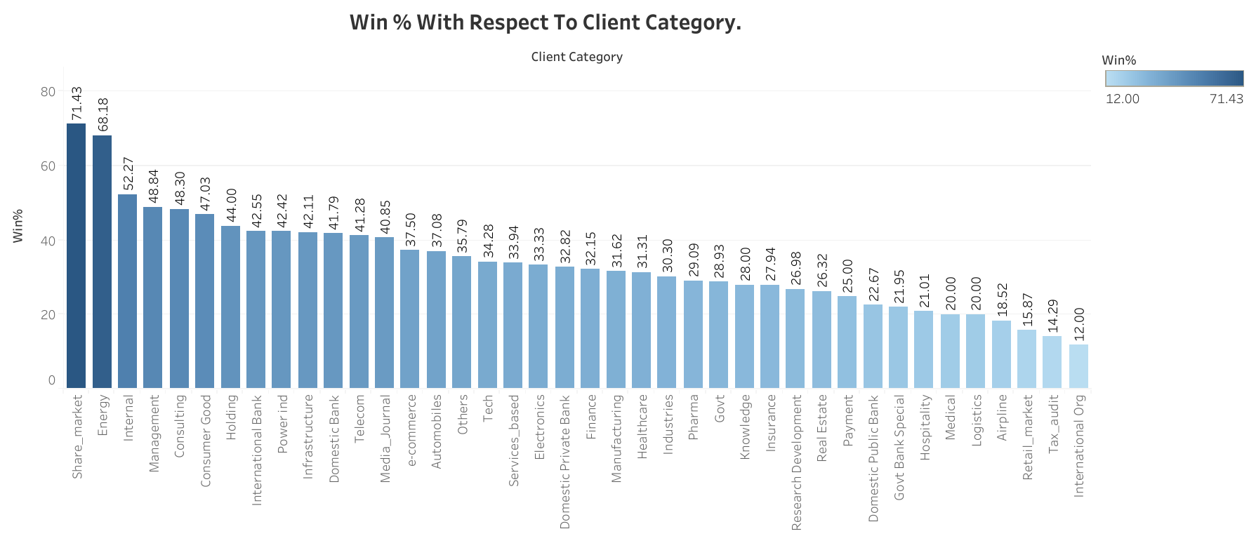

Slide 10
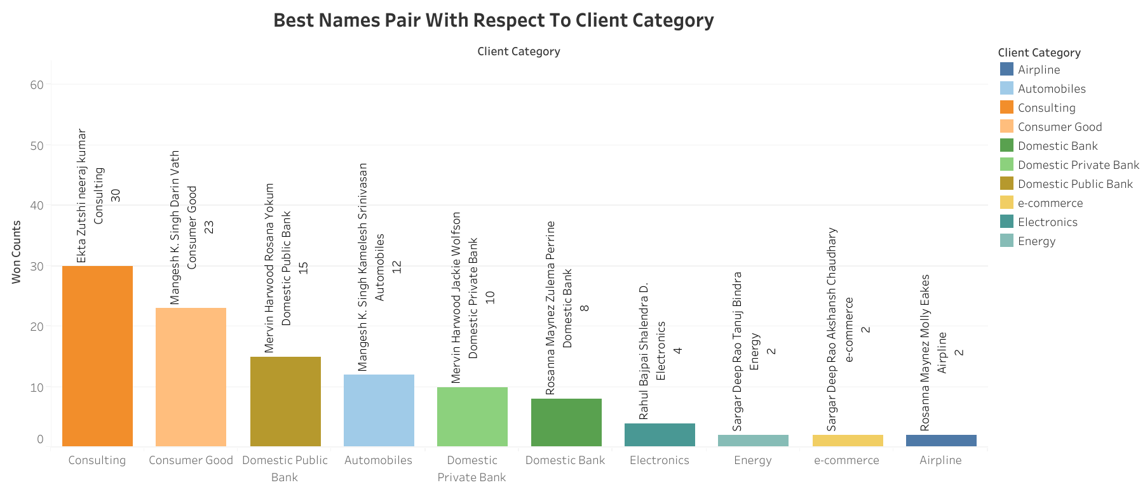

Slide 11
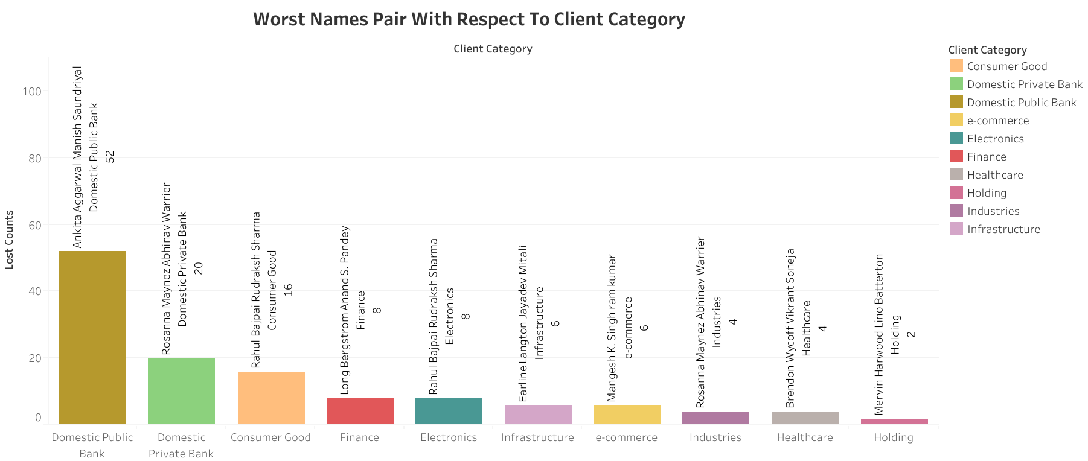

Slide 12
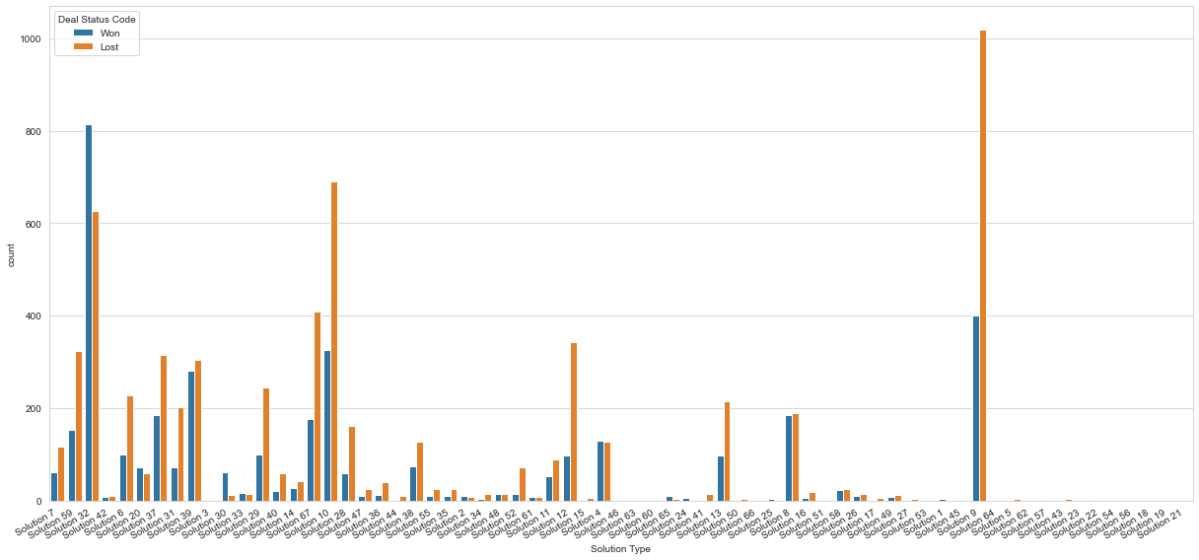
EDA: Solution Type Counts wrt Deal Status Code

Slide 13
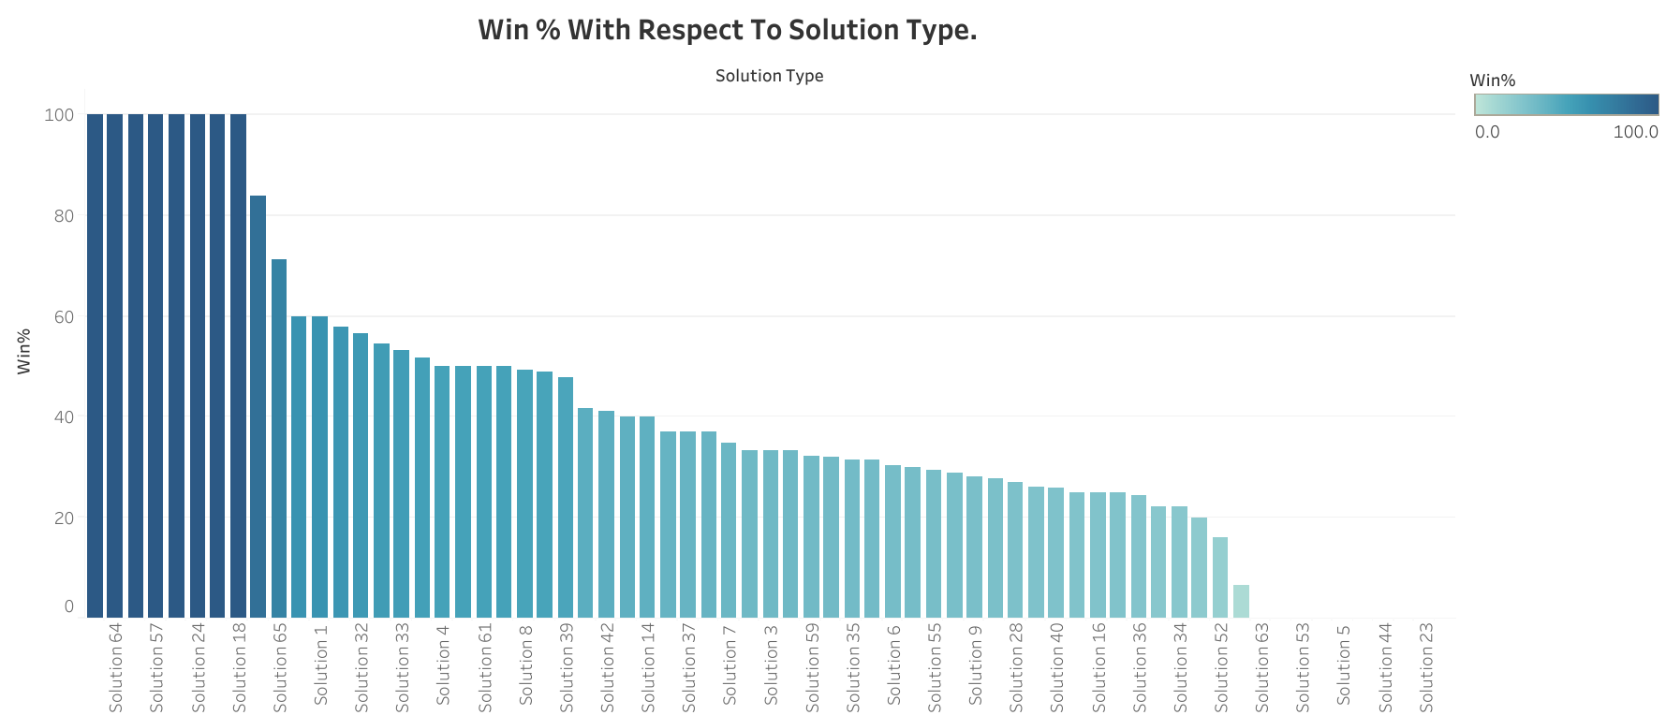

Slide 14
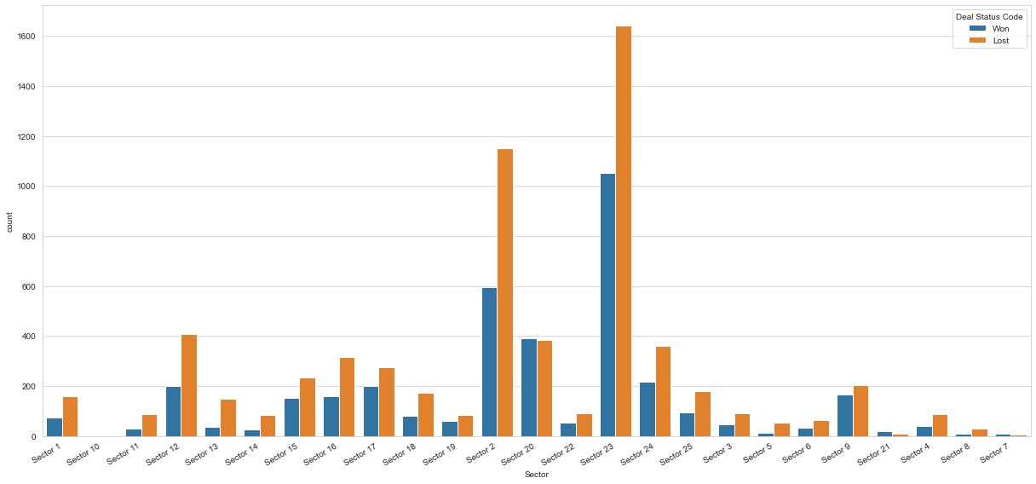
EDA: Sector Counts wrt Deal Status Code

Slide 15
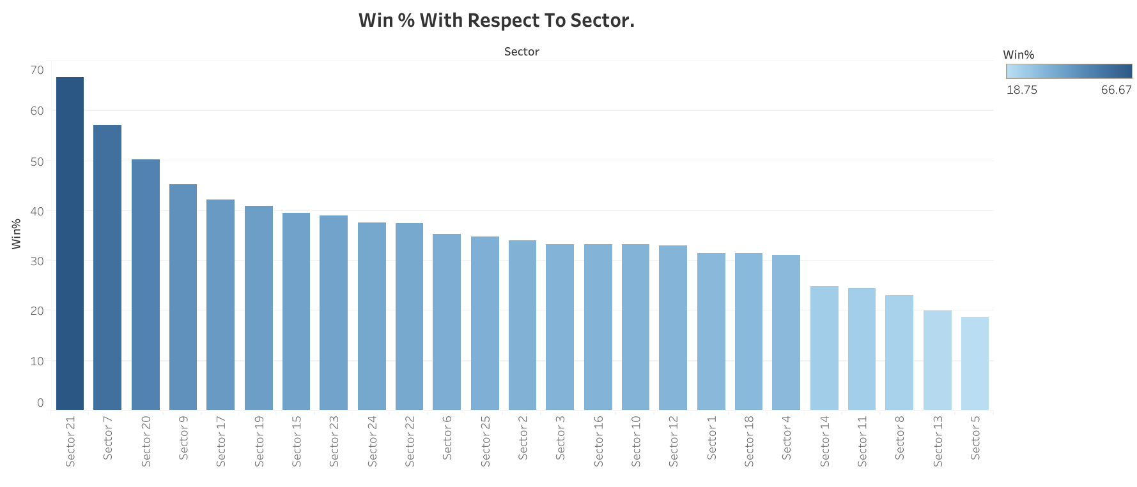

Slide 16
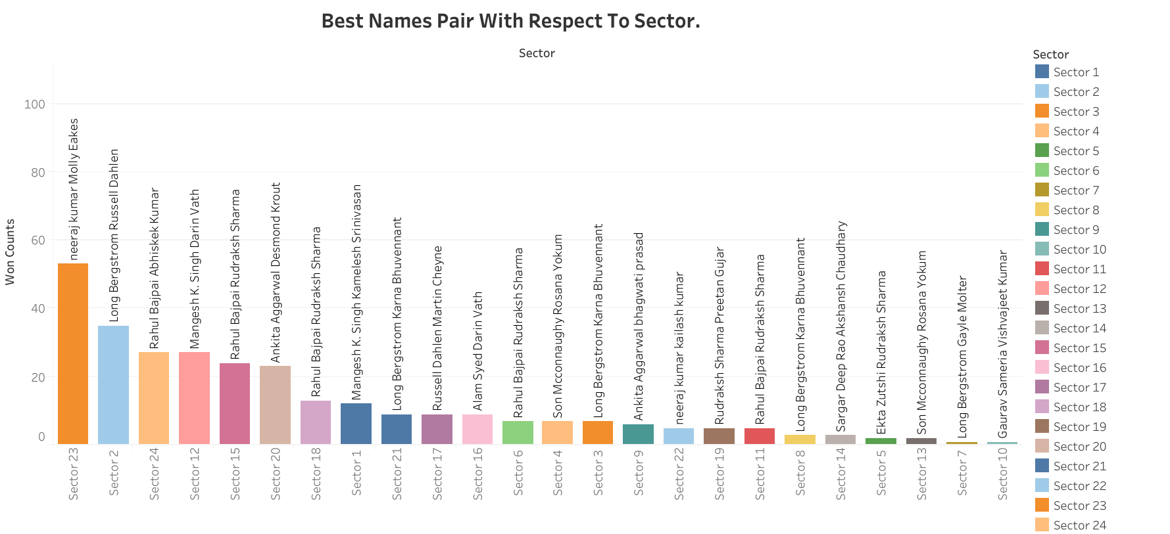

Slide 17
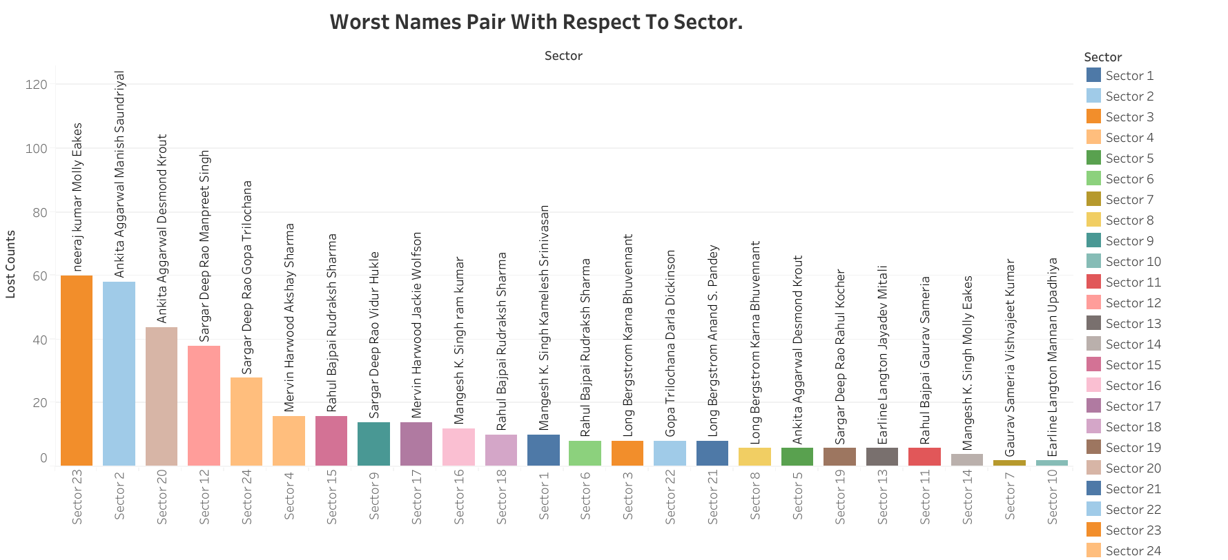

Slide 18
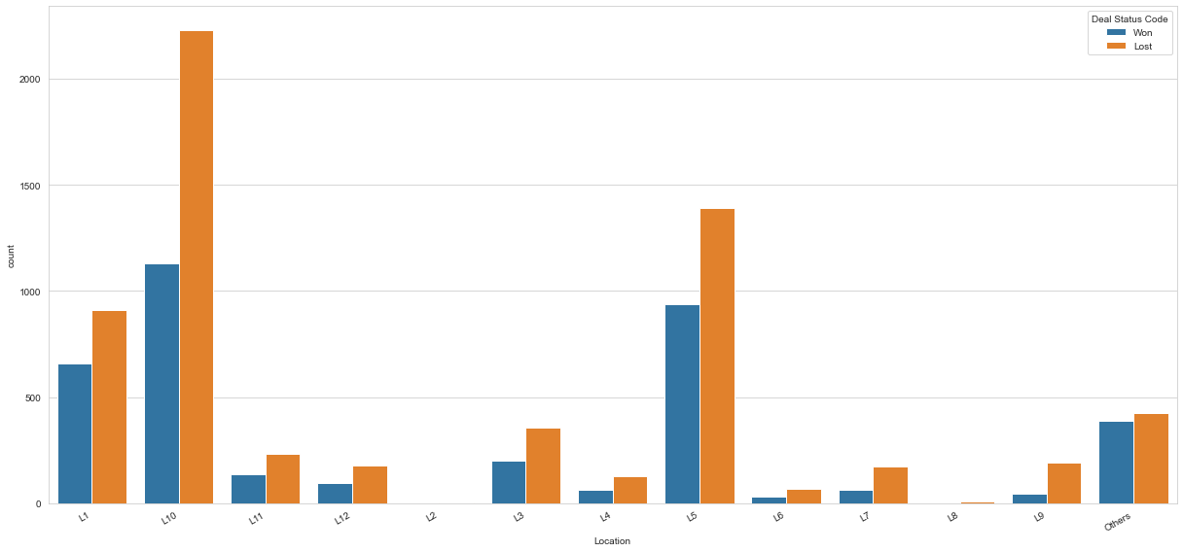
EDA: Location Counts wrt Deal Status Code

Slide 19
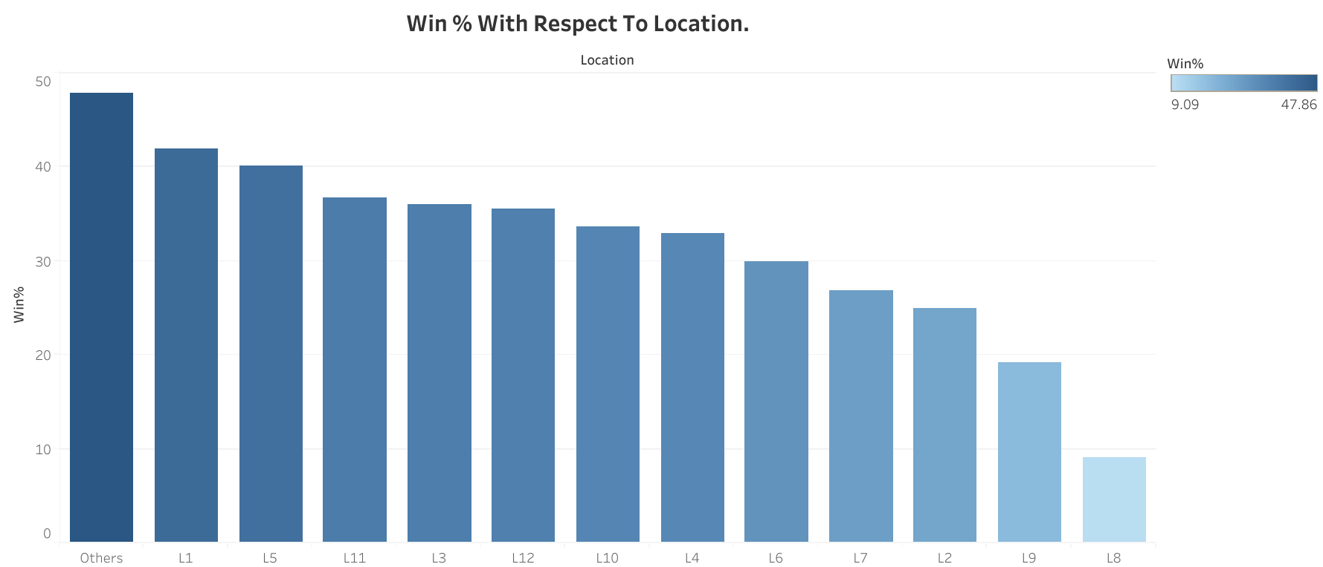

Slide 20
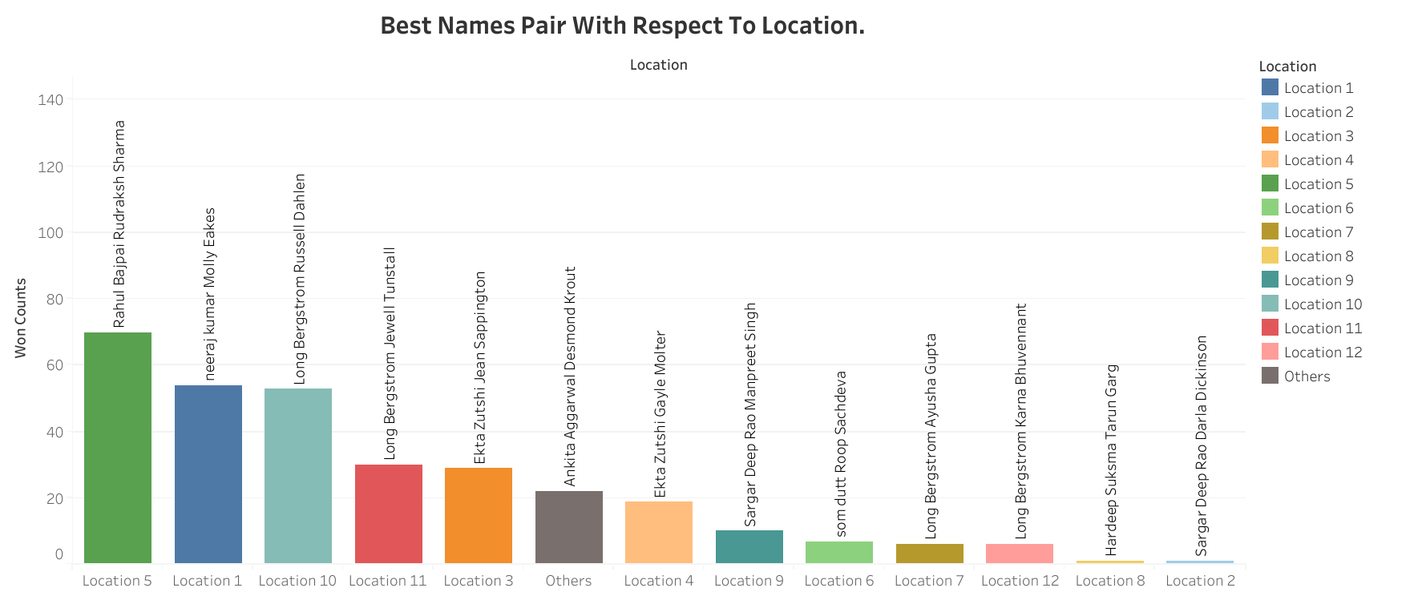

Slide 21
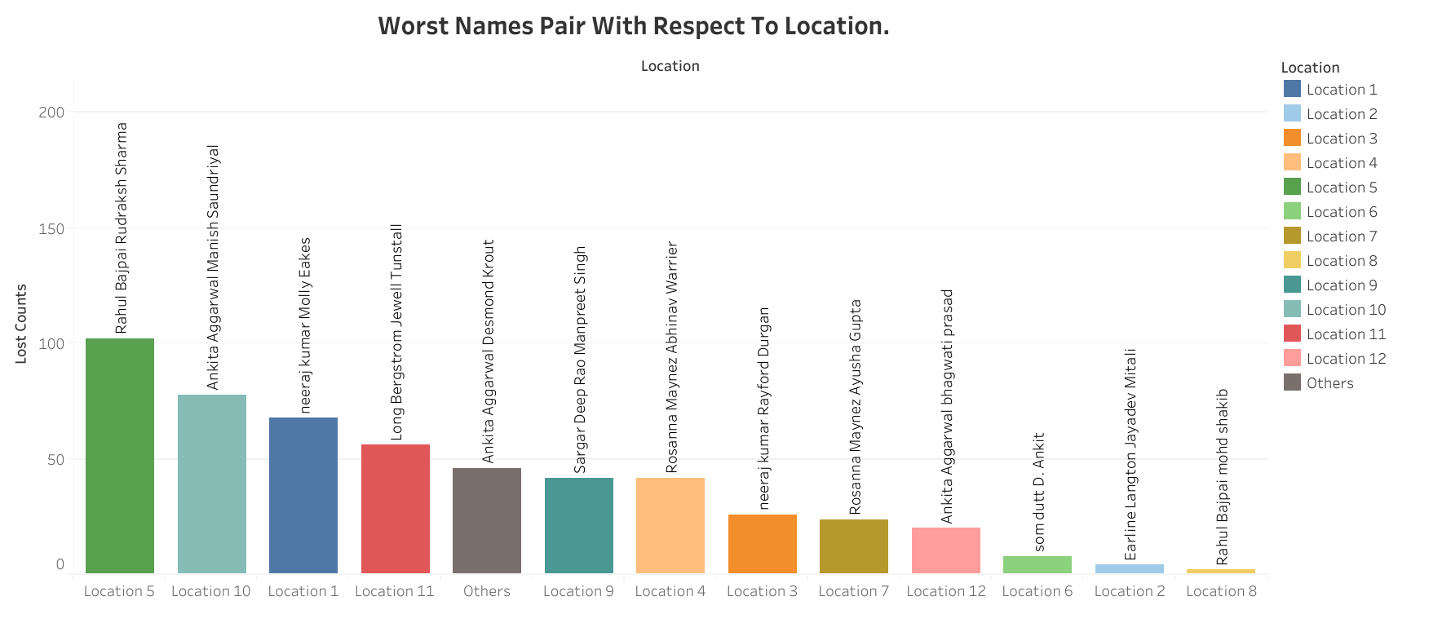

Slide 22
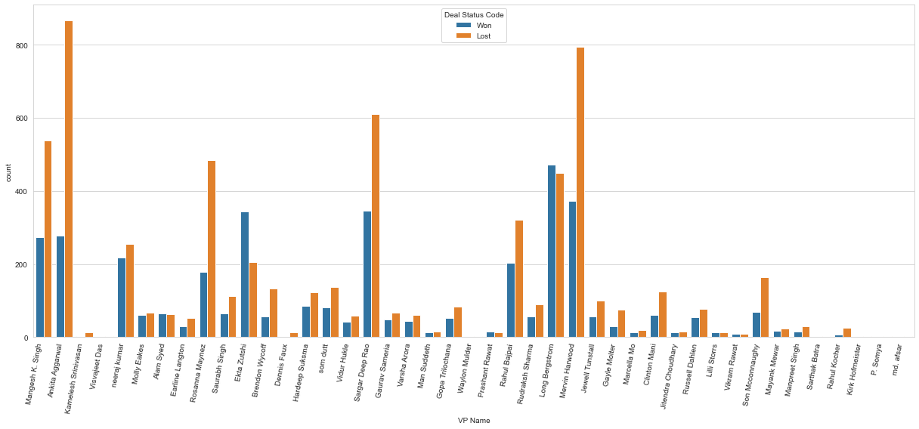
EDA: VP Names wrt Deal Status Code

Slide 23
Win%age of VP Name column
Deal Status Code VP Name | Lost | Won | Total | Win%
Ekta Zutshi | 206 | 344 | 550 | 62.545455
Prashant Rawat | 12 | 15 | 27 | 55.555556
Vikram Rawat | 8 | 9 | 17 | 52.941176
Long Bergstrom | 450 | 471 | 921 | 51.140065
Alam Syed | 62 | 64 | 126 | 50.793651
Molly Eakes | 66 | 60 | 126 | 47.619048
Lilli Storrs | 14 | 12 | 26 | 46.153846
neeraj kumar | 254 | 217 | 471 | 46.072187
Man Suddeth | 16 | 13 | 29 | 44.827586
Jitendra Choudhary | 16 | 12 | 28 | 42.857143

Slide 24
Win%age of Manager Name column
Deal Status Code Manager Name | Lost | Won | Total | Win%
Aastha Gandhi | 0 | 1 | 1 | 100.0
Anish Jonson | 0 | 1 | 1 | 100.0
Vaibhav Somaskandan | 0 | 2 | 2 | 100.0
Uzaar Ali | 0 | 1 | 1 | 100.0
Upendra Bhatt | 0 | 5 | 5 | 100.0
Taran Singh | 0 | 1 | 1 | 100.0
Sumita Verma | 0 | 2 | 2 | 100.0
Sumit Arora | 0 | 1 | 1 | 100.0
Sultan Khan | 0 | 1 | 1 | 100.0
Arti Bindra | 0 | 1 | 1 | 100.0

Slide 25

Data Pre-Processing/Cleaning
Columns | Counts
Client Category | 79
Solution Type | 0
Deal Date | 0
Sector | 0
Location | 0
VP Name | 0
Manager Name | 0
Deal Cost | 0
Deal Status Code | 0
Name Pair | 0
Year | 0
Month | 0
Quarter | 0
Handling Missing Value
Outliers Treatment: As a Data Analyst/Scientist we have to pre-process our data by cleaning it which includes missing values and outliers treatment. This step will help us to get clean data for model building

Slide 26
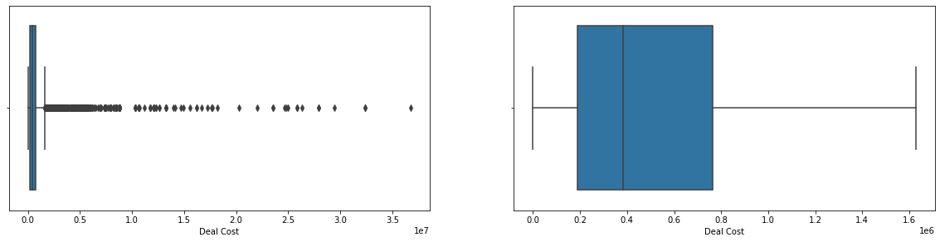
EDA: Deal Cost Box Plot
Deal Cost Variable With Outliers
Deal Cost Variable Without Outliers

Slide 27

Logarithmic Transformation
Log Transformation is used to make our Skewed Data(Deal Cost) more normal and balanced. It improves the linearity between our dependent and independent variables. It also boosts validity of our statistical analysis.
Log Transformation also de-emphasizes outliers. The idea is that taking the log of the data can restore symmetry to the data.

Slide 28

Data Encoding
We used Target Encoding to convert independent variables from Objects to Numerical.
We used Label Encoding to convert dependent variable from Objects to Numerical.
Target encoding involves replacing a categorical feature with average target value of all data points belonging to the category.

Slide 29

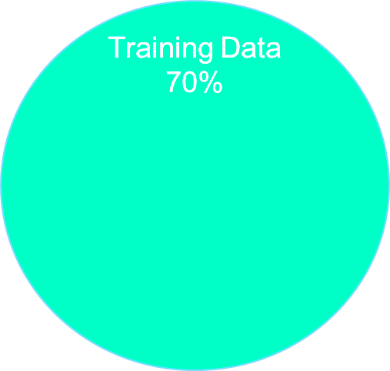
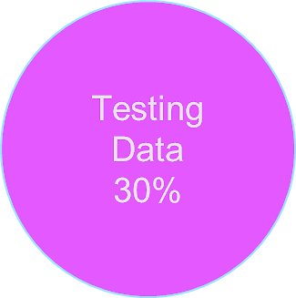
Splitting the data for Train & Test Model:Why Split ?
Data Set
100%
In machine learning, data splitting is typically done to avoid overfitting.
We need to split a dataset into train and test sets to evaluate how well our machine learning model performs
Splitting your dataset is essential for an unbiased evaluation of prediction performance
We need to split the data before Scaling to avoid Data Leakage.

Slide 30

Data Scaling
Input variables may have different units – that, in turn, may mean the variables have different scales.
Standardization requires that you know or are able to accurately estimate the mean and standard deviation of observed values.
Formula, :
Y= (X-Mean) /Standard Deviation
We used Standard Scaling technique to scale the data and assigned train and test variables before building a model.

Slide 31

Data Model Building
Now that we performed EDA’s and Data Pre-processing, we are moving on to Model Building.
We have opted for Logistic Regression Model as our baseline model. It is used for binary classification programs – 0 & 1.
We used for RFC as our final model and XG-Boost Classifier as our comparison model.

Slide 32

Accuracy Score & Hyper Parameter
Accuracy Based On Each Model
Logistic Regression
72.81%
Random Forest
83.64%
To check how well the models performed, we used accuracy score.
Furthermore, to boost the accuracy of the model, we opted for various parameters and here we used Random Search CV.
XG-Boost
82.69%

Slide 33
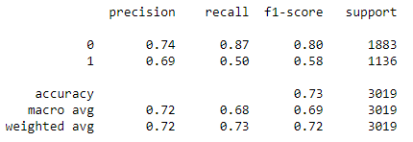
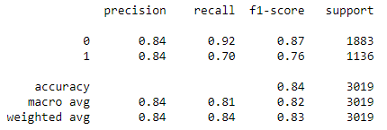
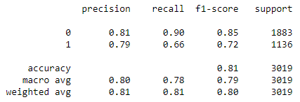
CLASSIFICATION REPORT FOR EACH MODEL
Logistic Regression
Random Forest
XG - Boost

Slide 34
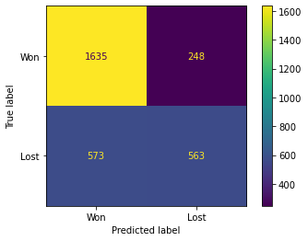
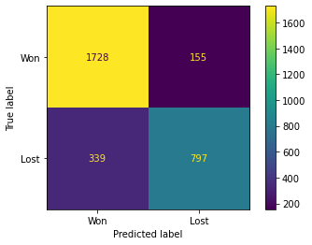
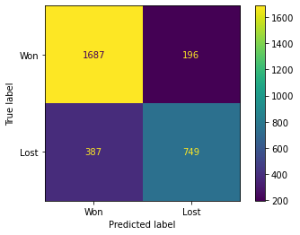
CONFUSION MATRIX FOR EACH MODEL
Logistic Regression
Random Forest
XG - Boost

Slide 35

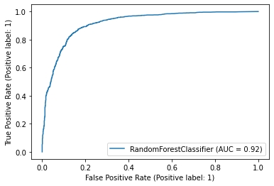
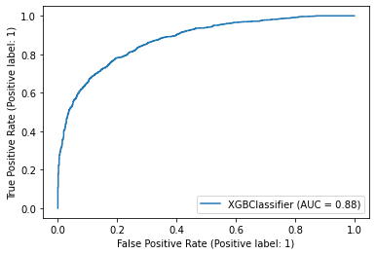
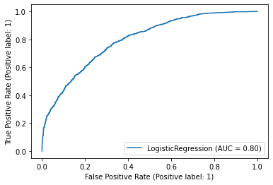
ROC Curve
Random Forest
XG - Boost
ROC (Receiver Operating Characteristics) curve is one of the most important evaluation metrics for checking any, specially, binary classification model’s performance. This curve plots two parameters:
True Positive Rate
False Positive Rate
It provides a graphical representation of a classifier’s performance, rather than a single value like most other metrics.
Logistic Regression

Slide 36


Testing and cross validation
After building our models we have move forward to evaluate it whether or model is a generalized model or not.
We used K-Fold Cross validation method to validate our model to check the performance.

Slide 37

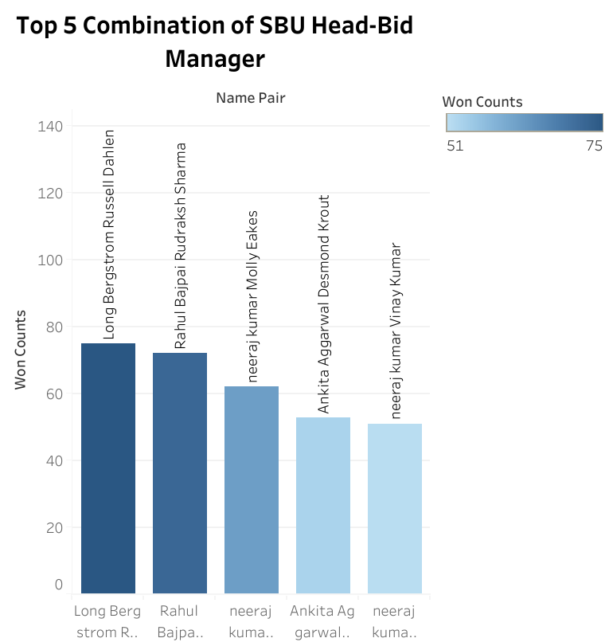
Top 5 Combination of SBU Head-Bid Manager

Slide 38

False Prediction Calculate The Loss Which The Company Will Face
We calculated that For every false prediction the loss which the company will face is 360492353.140

